Slide 1


Slide 2

Intro
The advent of cryptocurrency has introduced an intriguing paradox: pseudonymity allows criminals to hide in plain sight, but open data gives more power to investigators and enables the crowdsourcing of forensic analysis.
Notes:
加密货币的出现引出了一个耐人寻味的悖论:假名可以让犯罪分子隐藏在众目睽睽之下，而公开数据则为调查人员提供了更大的权力，并使法医分析得以众包化。

Slide 3
AML in a cryptocurrency world
The problem of higher relative costs is also, in part, a function of AML policy, which enforces high fixed costs of compliance on money service businesses (MSBs) along with the fear of criminal and monetary penalties for noncompliance – “low value" customers just aren’t worth the risk.
In May 2019, the Financial Crimes Enforcement Network (Fin- CEN) of the United States issued new guidance on how the Bank Secrecy Act (BSA) of 1970 applies to cryptocurrency, or what Fin- CEN calls convertible virtual currencies (CVC) [18]
In practice, one of the most challenging aspects of this is an implicit but effectively enforced requirement to not only know your customer, but to know your customer’s customer.
Whereas the pseudonymity of Bitcoin is an advantage for criminals, the public availability of data is a key advantage for investigators.
Notes:
低价值”客户根本不值得承担风险
但是考虑到向中低收入国家的全球汇款，2018年达到创纪录的5290亿美元，远远超过了全球1530亿美元的援助贡献。目前发送200美元的平均成本高达7%，一些国家的这一比例超过了10%。联合国可持续发展目标第10.7号的目标是到2030年减少到3%
在不降低数据分析的复杂性的前提下，我们提出了这样一个问题:有了正确的工具和开放的数据，我们能否帮助协调安全需求和金融包容的原因?
由比特币[17]引入的加密货币的出现，引发了人们对支付处理的技术和创业兴趣的爆炸式增长。在世界各地，资金转移初创公司纷纷成立，与西联汇款(Western Union)等传统银行和现金服务企业展开竞争。
实施勒索软件攻击，操纵黑市交易，交换非法商品和服务。
2019年5月，美国金融犯罪执行网络(Fin- CEN)发布了新的指导方针，说明1970年《银行保密法》(BSA)如何适用于加密货币，也就是Fin- CEN所说的可兑换虚拟货币(CVC)[18]
在法规遵循和政策圈中，“充分了解”客户意味着什么是争论的主题。在实践中，这方面最具挑战性的一个方面是一种含蓄但有效的强制要求，即不仅要了解客户，而且要了解客户的客户。在传统金融支离破碎的数据生态系统中，这方面的合规通常是通过企业与企业之间的电话来执行的
比特币的假名是犯罪分子的一个优势，而公开数据是调查人员的一个关键优势。

Slide 4
Blockchain
The Bitcoin big bang :https://info.elliptic.co/hubfs/big-bang/bigbang-v1.html
The bitcoin exploer: https://www.blockchain.com/explorer
Chainalysis video: 22:04

Slide 5
The Elliptic Data Set
The Elliptic Data Set maps Bitcoin transactions to real entities belonging to licit categories (exchanges, wallet providers, miners, licit services, etc.) versus illicit ones (scams, malware, terrorist organizations, ransomware, Ponzi schemes, etc.).
A given transaction is deemed licit (versus illicit) if the entity initiating the transaction (i.e., the entity controlling the private keys associated with the input addresses of a specific transaction) belongs to a licit (illicit) category1. Importantly, all features are constructed using only publicly available information.
Notes:
采用的是Elliptic（一家英国的比特币监控公司）提供的比特币数据集。包括合法类别的真实实体（交易所、钱包提供商、矿工、合法服务等），以及非法实体（诈骗、恶意软件、恐怖组织、勒索软件、庞氏骗局等）

Slide 6
Nodes and Edges
There are 203,769 node transactions and 234,355 directed edge payments flows. For perspective, using the same graph representation the full Bitcoin network has approxi- mately 438M nodes and 1.1B edges as of this writing.
In the Elliptic Data Set, two percent (4,545) are labelled class1 (illicit). Twenty-one percent (42,019) are labelled class2 (licit). The remaining transac- tions are not labelled with regard to licit versus illicit, but have other features.

Slide 7
Features
Each node has associated 166 features.
The first 94 features represent local information about the transaction – including the time step, number of inputs/outputs, transaction fee, output volume and aggregated figures such as average BTC received (spent) by the inputs/outputs and average number of incoming (outgoing) transactions associated with the inputs/outputs.
The remaining 72 features, called aggregated features, are obtained by aggregating transaction information one-hop backward/forward from the center node - giving the maximum, minimum, standard deviation and correlation coefficients of the neighbour transactions for the same information data (number of inputs/outputs, transaction fee, etc.).
Notes:
每个节点都关联了166个交易相关的特征。
原生特征（94个）LF：时间步长、入度和出度、交易费、输出量以及衍生统计特征（如相关联交易的平均数量、平均接受/使用的BTC）
聚合特征（72个）：通过从中心节点向后/向前一跳聚合交易信息来获得（邻居相关原生特征的最大、最小、标准差和相关系数）

Slide 8
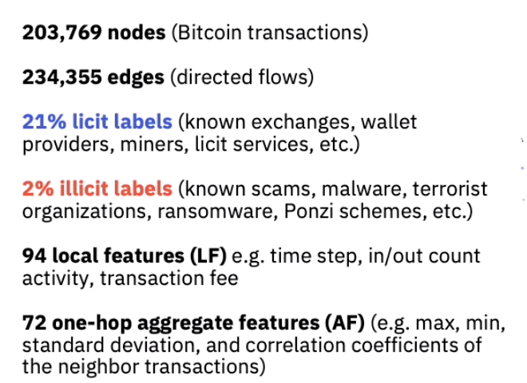

Slide 9
Temporal Information
A time stamp is associated with each node, representing an estimate of the time when the transaction is confirmed by the Bitcoin network. There are 49 distinct time steps, evenly spaced with an interval of about two weeks. Each time step contains a single connected component of transactions that appeared on the blockchain within less than three hours between each other; there are no edges connecting different time steps. Clearly the nodes in a specific time step have associated time stamps very close to each other, so effectively each one of them can be thought of as an instantaneous “snapshot” in time. The number of nodes for each time step is reasonably uniform over time (ranging from 1,000 to 8,000 nodes).
Notes:
每个节点会和时间信息相关联，这里的时间信息指的是比特币网络确认交易时的估计时间。若考虑时间信息，则将约2周为时间间隔划分成49个不同的时间步长。
在每个时间步长上，都包含一个连通分量，它们之间的相互交易在区块链上出现的时间小于3个小时，也不会存在于其他时间步长中节点相连接的边。
每个节点会和时间信息相关联，这里的时间信息指的是比特币网络确认交易时的估计时间。若考虑时间信息，则将约2周为时间间隔划分成49个不同的时间步长。
在每个时间步长上，都包含一个连通分量，它们之间的相互交易在区块链上出现的时间小于3个小时，也不会存在于其他时间步长中节点相连接的边。

Slide 10
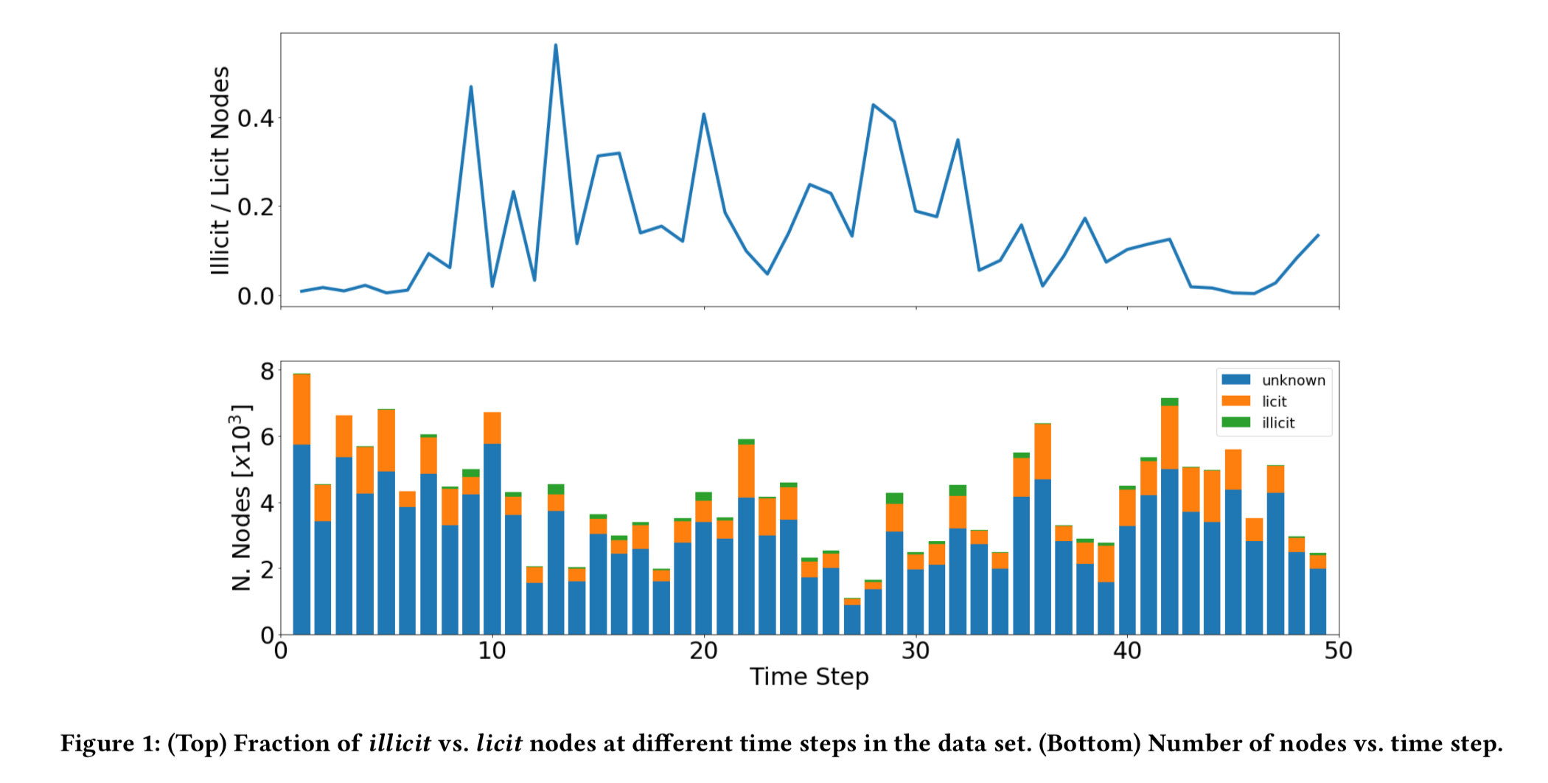

Slide 11
Notes on Feature Construction
Additionally, there are two major challenges in building features for Bitcoin transactions. The first is rooted in the size of the Bitcoin blockchain amounting to 200GB of compressed data and about 400 million addressed transactions. Though not all transactions are included in the subset used in this study, it is still necessary to access the complete blockchain in order to observe the full history of wallets participating in the selected transactions. To overcome this, Elliptic uses a high-performance all-in-memory graph engine for the computation of features.
The second challenge arises from the underlying graph structure of the data and the heterogeneity in the number of neighbors a transaction can have. In building the 72 aggregated features, the problem of heterogeneous neighborhoods is addressed by naively constructing statistical aggregates (minimum, maximum, etc.) of the local features of a neighbor transaction. In general, this solution is sub-optimal because it carries a significant loss of information. We address this in our forthcoming discussion of graph deep learning methods, which may better account for the local graph topology.
Notes:
在构建比特币交易功能方面存在两个主要挑战。第一个是基于比特币区块链的大小，相当于200GB的压缩数据和大约4亿的地址交易。虽然不是所有的交易都包括在这个研究中使用的子集中，但是仍然需要访问完整的区块链，以观察钱包参与所选交易的完整历史。为了克服这一点，Elliptic使用高性能的全内存图形引擎来计算特性。
第二个挑战来自于数据的底层图结构和事务可以拥有的邻居数量的异构性。在构建72个聚合特性时，通过天真地构造邻居事务的本地特性的统计聚合(最小、最大等)，解决了异构邻域的问题。一般来说，这个解决方案是次优的，因为它带来了大量信息的丢失。我们将在即将讨论的图数据深度学习方法中讨论这个问题，这种方法可以更好地解释局部图的拓扑结构。

Slide 12
Benchmark Methods
Given the features previously described, benchmark machine learning methods use the first 94 features in supervised learning for binary classification.
Such techniques include Logistic Regression [1], Multilayer Perceptron (MLP) (ibid), and Random Forest [2]. In MLP, each input neuron takes in a data feature and the output is a softmax with a probability vector for each class. Logistic Regression and Random Forest are popular for AML, especially when used in concert with one another for their respective advantages—Random Forest for accuracy and Logistic Regression for explainability. These methods, however, do not leverage any graph information.
In the Elliptic Data Set, the local features are enhanced with a set of 72 features that contain information about the immediate neighbourhood. We will see the utilization of these features improves performance. While this approach shows the graph structure carries in the binary classification problem, and that this can be used with standard machine learning techniques, it is challenging to extend the purely feature-based method beyond the immediate neighbourhood. This drawback motivates the use of Graph Convolutional Networks.
Notes:
AML分析是一种异常检测挑战，它需要在海量的、不断增长的数据集中准确地分类少量非法交易。行业标准的高达90%的假阳性率抑制了这种努力。我们希望在不增加假阴性率的情况下降低假阳性率，即在不允许更多罪犯的情况下让更多无辜的人参与进来
基准机器学习方法使用监督学习的前94个特征进行二分类。这些技术包括逻辑回归[1]、多层感知器(MLP)(同上)和随机森林[2]。在MLP中，每个输入神经元接受一个数据特征，输出是一个带有每个类的概率向量的softmax。Logistic回归和随机森林在AML中很受欢迎，尤其是当它们各自的优势——随机森林的准确性和逻辑回归的可解释性——同时使用时。但是，这些方法不利用任何图形信息。
在椭圆型数据集中，局部特征被一组包含直接邻近信息的72个特征增强。我们将看到这些特性的使用提高了性能。虽然这种方法显示了图结构存在于二元分类问题中，并且这种方法可以与标准的机器学习技术一起使用，但是将纯粹基于特征的方法扩展到近邻之外是一个挑战。这个缺点促使了Graph Convolutional Networks的使用。

Slide 13
Training Data
70:30 temporal split of training and test data, respectively. 70:30 temporal split of training and test data, respectively. (the first 34 time steps are used for training the model and the last 15 for test.)

Slide 14
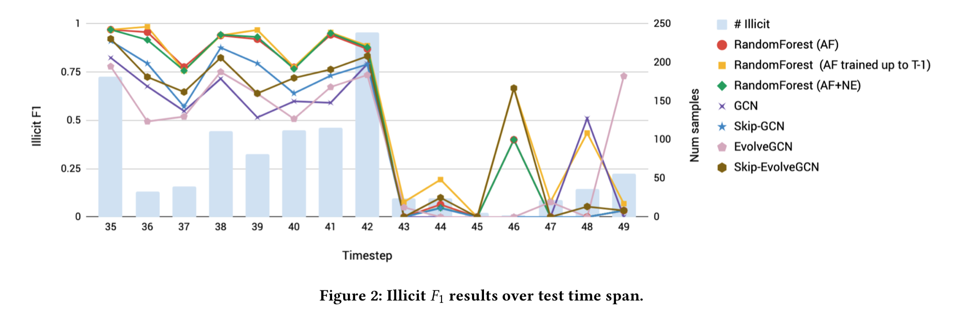
Experiment Result

Slide 15
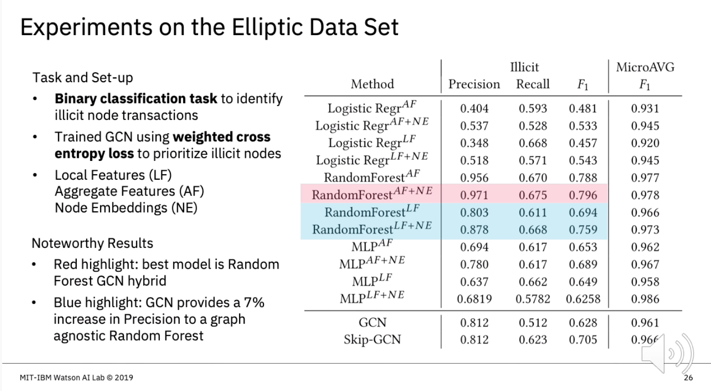
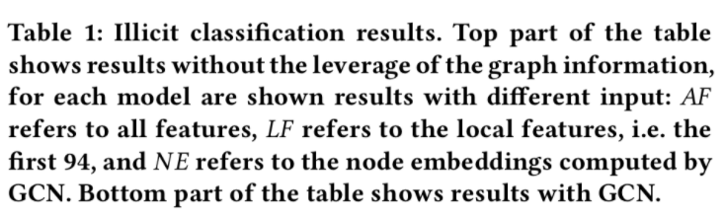

Slide 16
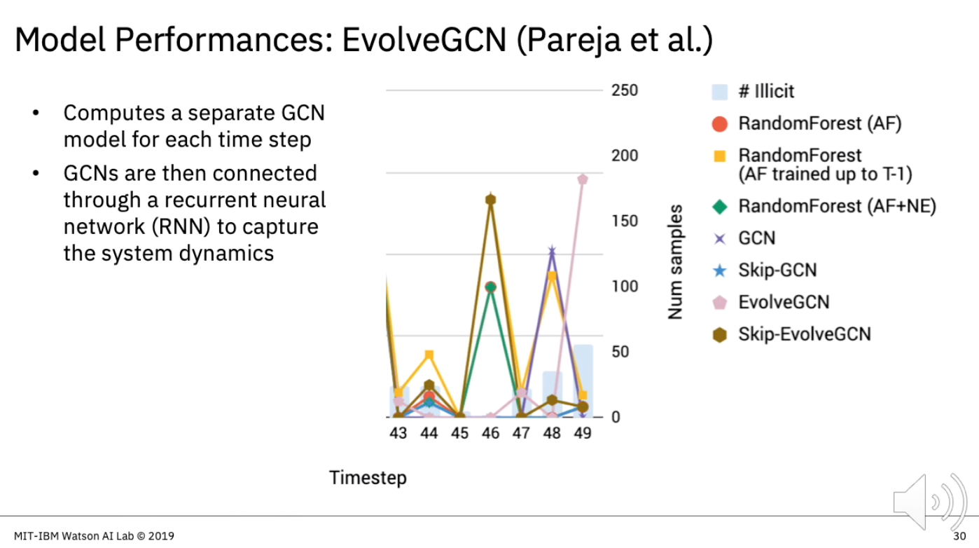

Slide 17
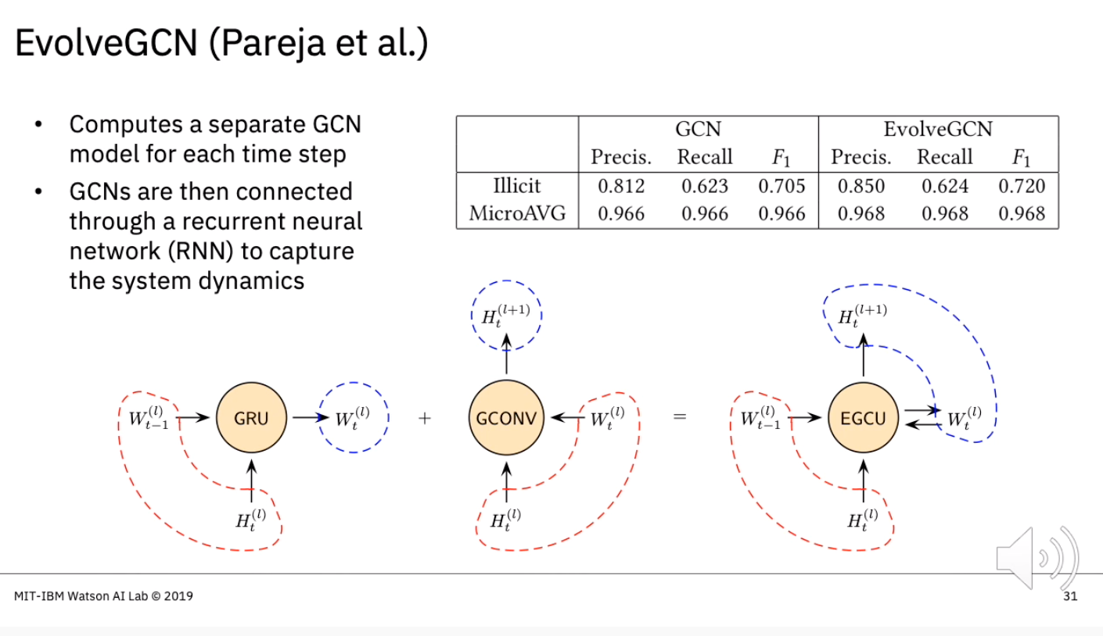

Slide 18
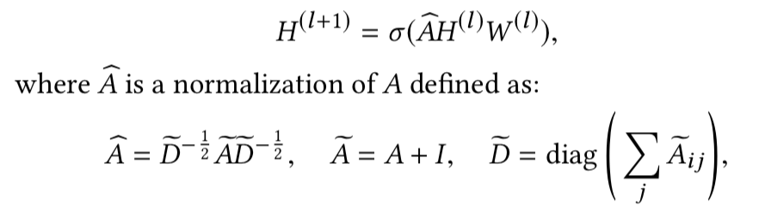
Graph Convolutional Networks (GCN)
the Bitcoin transaction graph from the Elliptic Data Set as G = (N , E), where N is the set of node transactions and E is the set of edges representing the flow of BTC. The l -th layer of the GCN takes the adjacency matrix A and the node embedding matrix H (l ) as input, and uses a weight matrix W (l ) to update the node embedding matrix to H (l +1) as output. Mathematically, we write

Slide 19
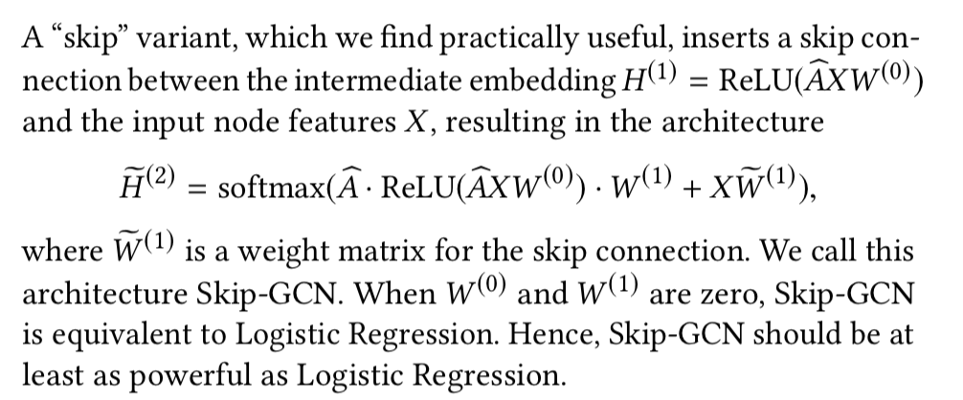
Notes:
与GCN相比，多了一个“skip”变量，即将节点输入特征X和网络embedding特征共同进行学习，其好处是相当于在GCN中增加了一个LR的结构。

Slide 20
Temporal Modeling
Financial data are inherently temporal as transactions are time stamped. It is reasonable to assume there exists certain dynamics, albeit hidden, that drive the evolution of the system. A prediction model will be more useful if it is designed in a manner to capture the dynamism. This way, a model trained on a given time period may better generalize to subsequent time steps. The better the model captures system dynamics, which are also evolving, the longer horizon it can forest into.
A temporal model that extends GCN is EvolveGCN [19], which computes a separate GCN model for each time step. These GCNs are then connected through a recurrent neural network (RNN) to capture the system dynamics. Hence, the GCN model for a future time step is evolved from those in the past, where the evolution captures the dynamism.
In EvolveGCN, the GCN weights are collectively treated as the system state. The model is updated upon an input to the system every time, by using an RNN (e.g., GRU). The input is the graph information at the current time step. The graph information may be instantiated in many ways; in EvolveGCN, it is represented by the embeddings of the top-k influential nodes in the graph.
Notes:
GCN的时间模型是EvolveGCN，具体方法详见《EvolveGCN: Evolving Graph Convolutional Networks for Dynamic Graphs》。

Slide 21
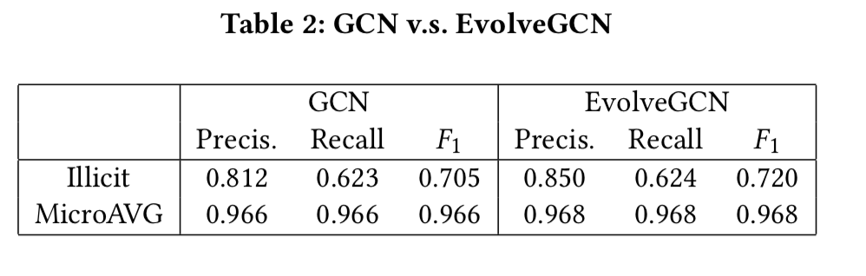
Notes:
Table 2 compares the prediction performance between the non- temporal GCN and the temporal EvolveGCN. EvolveGCN consis- tently outperforms GCN, although the improvement is not substan- tial for this data set. One avenue of further investigation is the use of alternative forms of system input to drive the recurrent update inside GRU.

Slide 22
Emerging events
The Dark Market Shutdown. An important consideration for AML is the robustness of a prediction model with respect to emerg- ing events. One interesting aspect of this data set is the sudden closure of a dark market occurring during the time span of the data (at time step 43). As seen in Figure 2, this event causes all methods to perform poorly after the shutdown. Even a Random Forest model re-trained after every test time step, assuming the availability of ground truth after each time, is not able to reliably capture new illicit transactions after the dark market shutdown. The robustness of methods to such events emerges as a major challenge to address.
Notes:
The Dark Market Shutdown. An important consideration for AML is the robustness of a prediction model with respect to emerg- ing events. One interesting aspect of this data set is the sudden closure of a dark market occurring during the time span of the data (at time step 43). As seen in Figure 2, this event causes all methods to perform poorly after the shutdown. Even a Random Forest model re-trained after every test time step, assuming the availability of ground truth after each time, is not able to reliably capture new illicit transactions after the dark market shutdown. The robustness of methods to such events emerges as a major challenge to address.

Slide 23
Discussion
We have seen Random Forest significantly outperforms Logistic Regression; in fact, it also outperforms GCN even though the latter is empowered by the graph structure information. Random Forest uses a voting mechanism to ensemble the prediction results from a number of decision trees, each trained by using a subsample of the data set. GCN, in contrast, like most deep learning models, uses Logistic Regression as the final output layer; hence, it can be considered a nontrivial generalization of Logistic Regression.
The question arises: Is it possible to combine a Random Forest with a graph neural network? One simple idea is to augment the node features with the embeddings computed from GCN before running Random Forest. This idea helps only marginally according to prior experimentation. Another idea, as proposed by [13], is to parameterize every node in the decision tree(s) by using a feed- forward neural network. This idea organically combines Random Forest with neural networks, but it does not suggest how graph in- formation can be incorporated. One possible approach is to replace the Logistic Regression output layer in GCN by this differentiable version of the decision tree, so that end-to-end training is enabled. We leave the execution of this idea as future investigation.
Notes:
我们已经看到随机森林显著优于逻辑回归;事实上，它的性能也优于GCN，尽管GCN是由图结构信息支持的。随机森林使用投票机制来集成来自许多决策树的预测结果，每个决策树都使用数据集的子样本进行训练。与此相反，与大多数深度学习模型一样，GCN使用逻辑回归作为最终的输出层;因此，它可以被认为是逻辑回归的一个重要的概括。
问题出现了:是否有可能将一个随机森林与一个图神经网络结合起来?一个简单的想法是使用在运行Random Forest之前从GCN计算的嵌入来增加节点特性。根据先前的实验，这一想法只会有些许帮助。[13]提出的另一个想法是使用前馈神经网络对决策树中的每个节点进行参数化。这个想法将随机森林和神经网络有机地结合在一起，但它并没有建议如何将图的信息合并在一起。一种可能的方法是用这种可微分的决策树替换GCN中的逻辑回归输出层，以便启用端到端培训。我们把这个想法的执行留作以后的研究。

Slide 24
Reference
https://www.youtube.com/watch?v=HtJeXPr_PBY

Slide 25
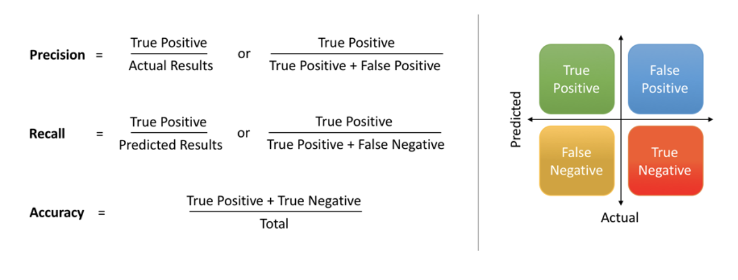

Slide 26
